Slide 1
TMAP Specification and Example mapping worksheet
Legend
Feature / Story
Copy and paste the cards below as required
Rule
Example
Question
(© Sogeti / TMAP 2024)
Notes:
This template is based on section 35.2.2 of the TMAP book “Quality for DevOps teams”.

Slide 2
TMAP Specification and Example mapping worksheet
Legend
Feature / Story
Copy and paste the cards below as required
Rule
Example
Question
(© Sogeti / TMAP 2024)
Notes:
This template is based on section 35.2.2 of the TMAP book “Quality for DevOps teams”.

Slide 3
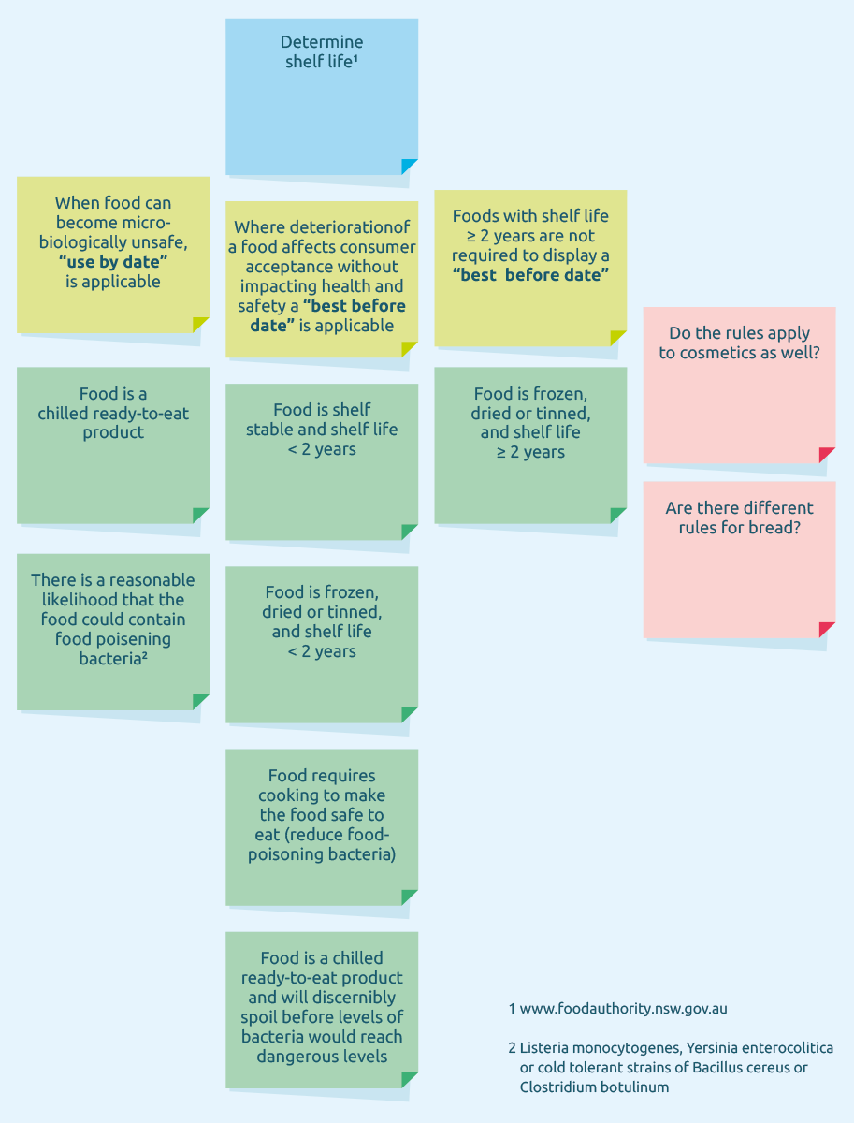
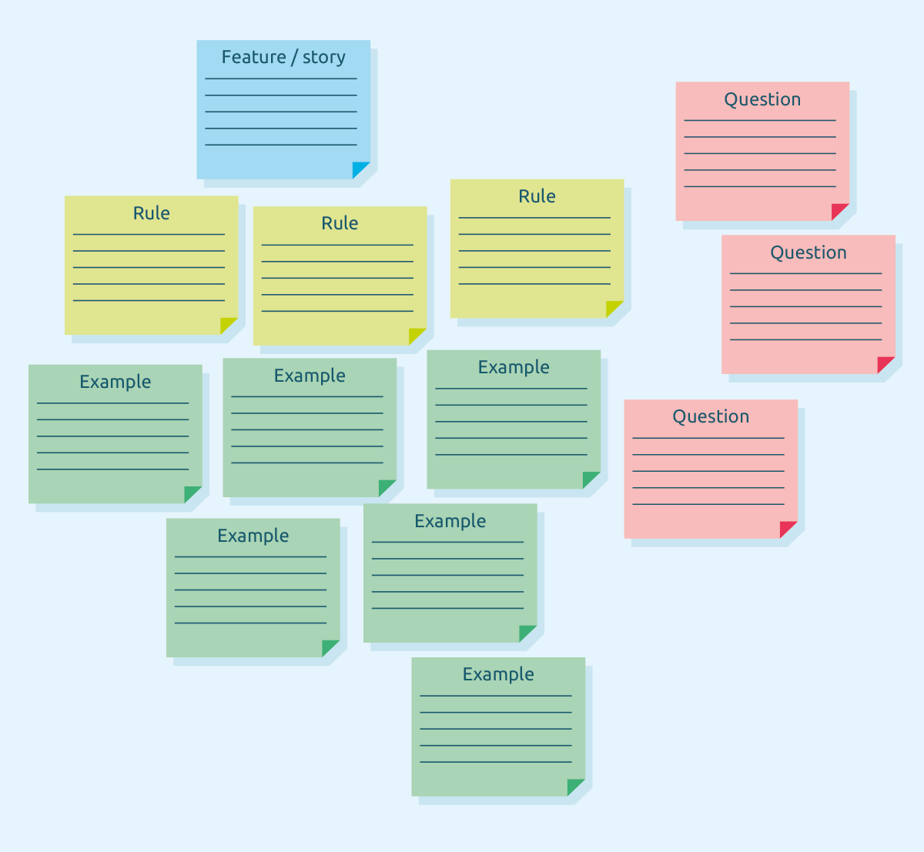
Template and Example from chapter 35 of the TMAP book “Quality for DevOps teams”

